Slide 1
Autonomous Vehicles
Research Studio
Quanser innovation unleashed in the drone research space

Slide 2
Question
Answer
Notes:
Quanser is an amalgamation of Question and Answer (*ESL regions: Quanser equals Question + Answer works as well). We are an academically focused company who strive to empower professors, students are researchers to ask the challenging questions and embark on the journey to find the answers.
*Look for a dominant Question of the session at hand… “

Slide 3
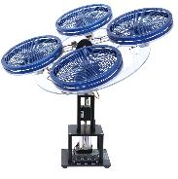
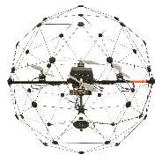
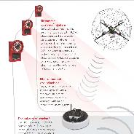
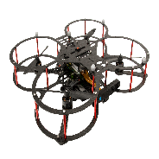
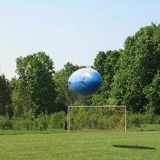
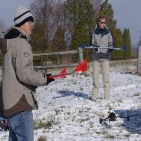

Multi-vehicle
Systems Lab
Next Gen of
Research Drone
Stationary Testbeds
Flying Quadcopters
2006
2008
1998
2007
2018
Intelligent Remote
Sensing Using ALTAV
Cooperative Control
System
Enhanced UGV via Haptic
and Tactile Feedback

Slide 4
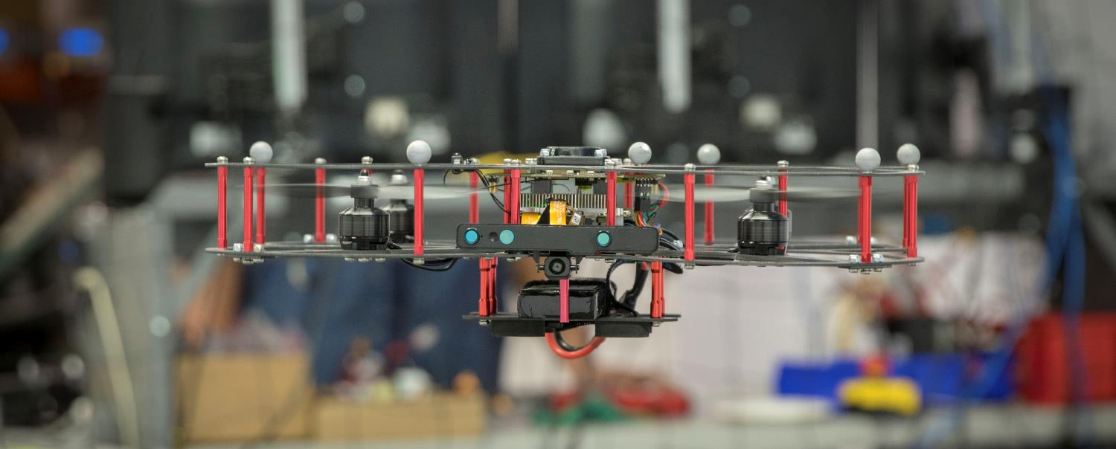
The only option for research groups looking to jumpstart autonomous robotics research programs and be productive in a very short amount of time.
Quanser innovation unleashed in the drone research space

Slide 5
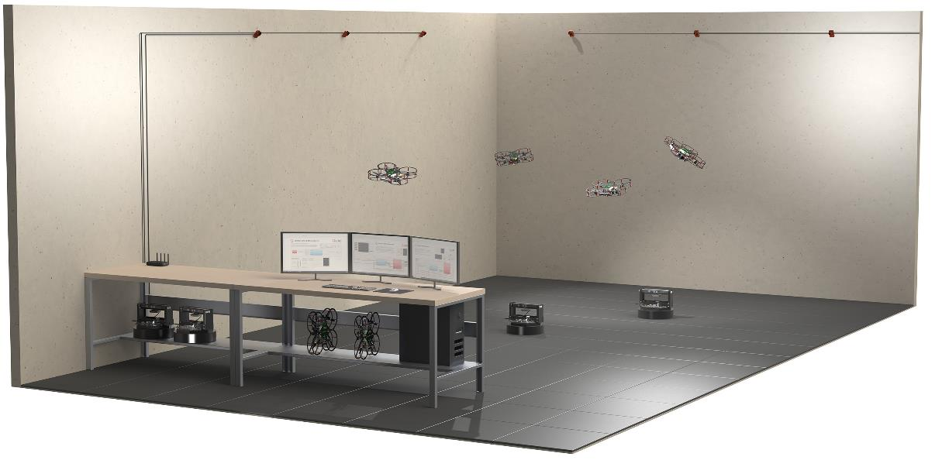
Complete Turnkey Research Studio
Natural Point OptiTrack
QDrone
QBot 2e
High performance computer
  Intel Core i7
  32GB DDR4 RAM
  Three monitors
USB flight controller
High performance router
Also included:
Battery chargers
Protective net
Protective floor tiles
Ground camera

Slide 6
Rapid Research
Development
Advanced flight control
  Fault tolerance
  Dynamic docking
  Landing on moving vehicles
  Non-vertical takeoff/landing
Swarm intelligence
Machine vision
Collision avoidance
SLAM and autonomy
Surveillance and mapping
Machine learning and AI
Payload balance and transfer
Multivehicle collaboration
Mass data collection
Sensory network
Sensor fusion
Search and rescue
Heterogeneous swarm
Quickly iterate on concepts
Benchmark for validation and testing

Slide 7
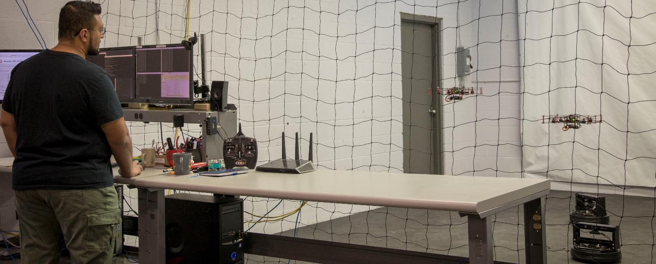
Features - Autonomous Vehicle Research Studio

Slide 8
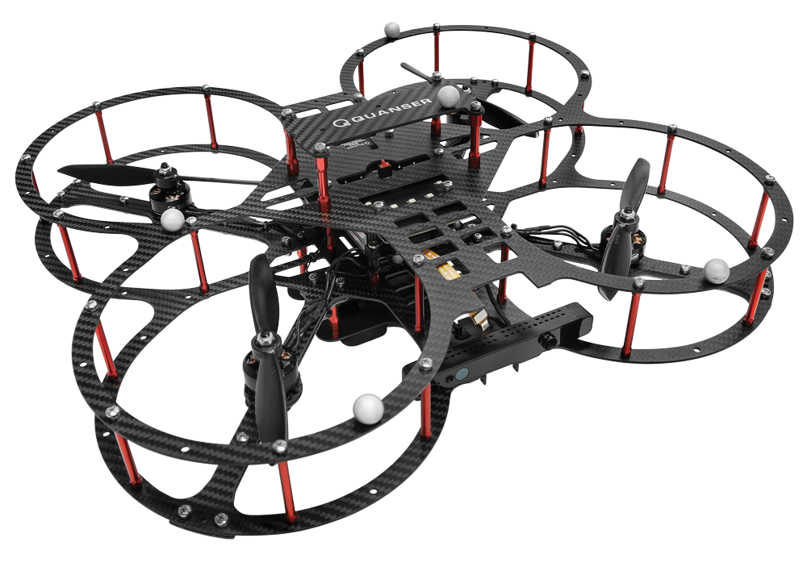
QDrone - Features

Slide 9
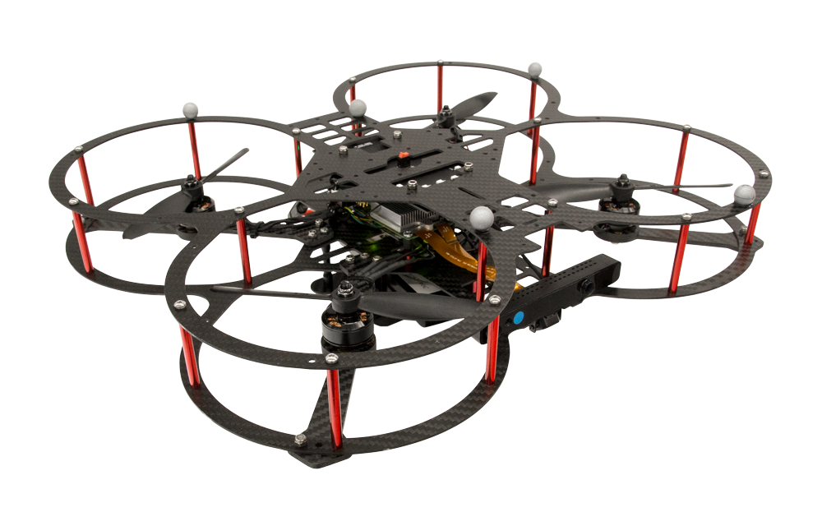
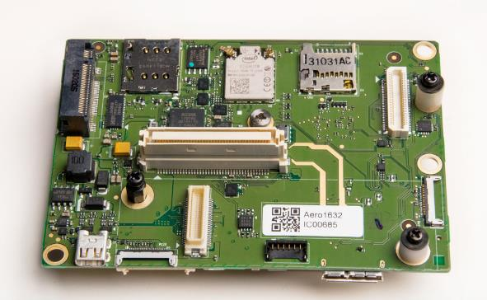
Onboard Computing
Intel® Aero Compute Board
  Intel Atom® x7-Z8750 quad-core 64-bit 2.56 GHz
  GPU
  IMU
  Magnetometer
  Barometer
  Dual-band 2.4/5GHz WiFi
Expandable I/O
  PWM (8x)
  UART (2x)
  SPI (3x SS pins)
  I²C
  ADC (4x)
  Encoder input (3x)
  CPU GPIO (5x)
Notes:
Intel Aero Compute Board
Intel Atom x7-Z8750 quad-core 64-bit 2.56 GHz
GPU ?
IMU
Magnetometer
Barometer
5G WiFi

Slide 10
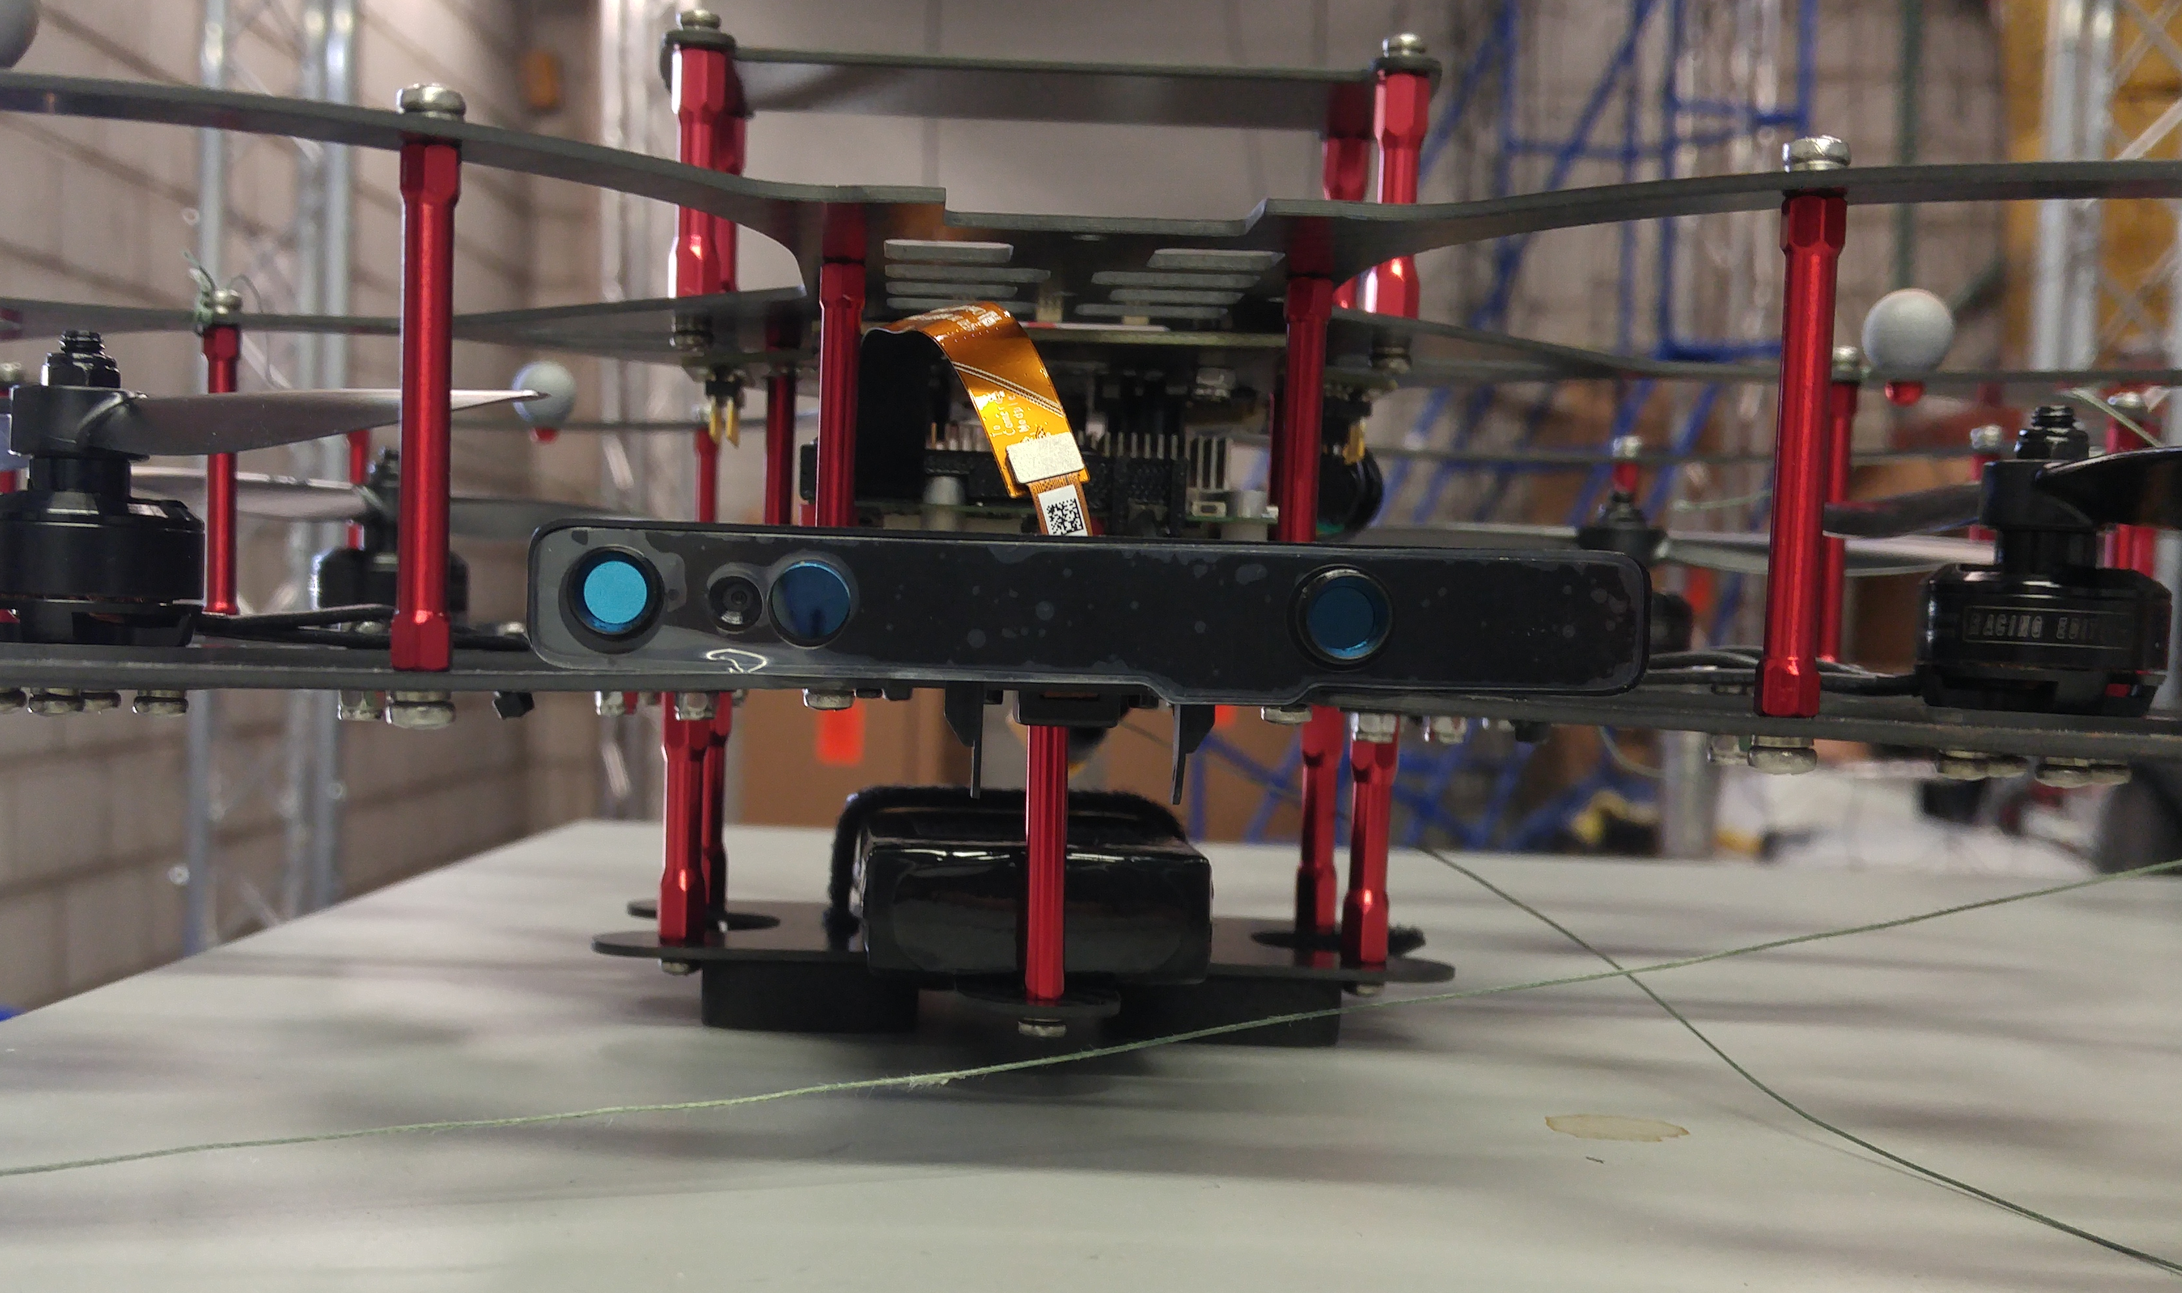
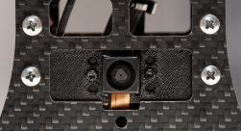
Multiple Cameras
Depth & Vision: Intel RealSense (R200)
  RGBD ● 1080p @ 30FPS
Downward optical flow: Omnivision OV7251
  VGA ● 640x480 @ 120 FPS

Slide 11
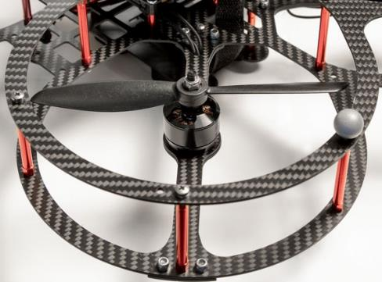
Robust Design
Actuation
  6” dual-blade propellers
  Cobra 2208 brushless DC motors
Frame
  Custom impact-resistant carbon fibre frame

Slide 12
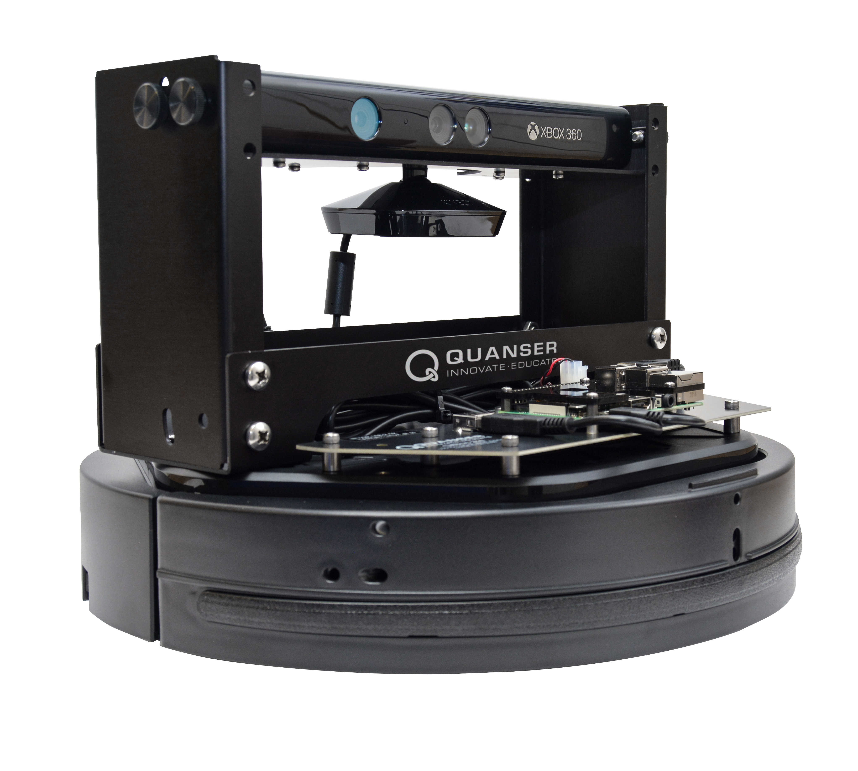
QBot 2e - Features

Slide 13
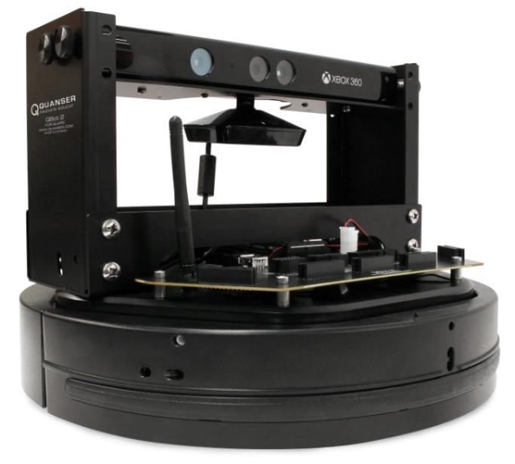
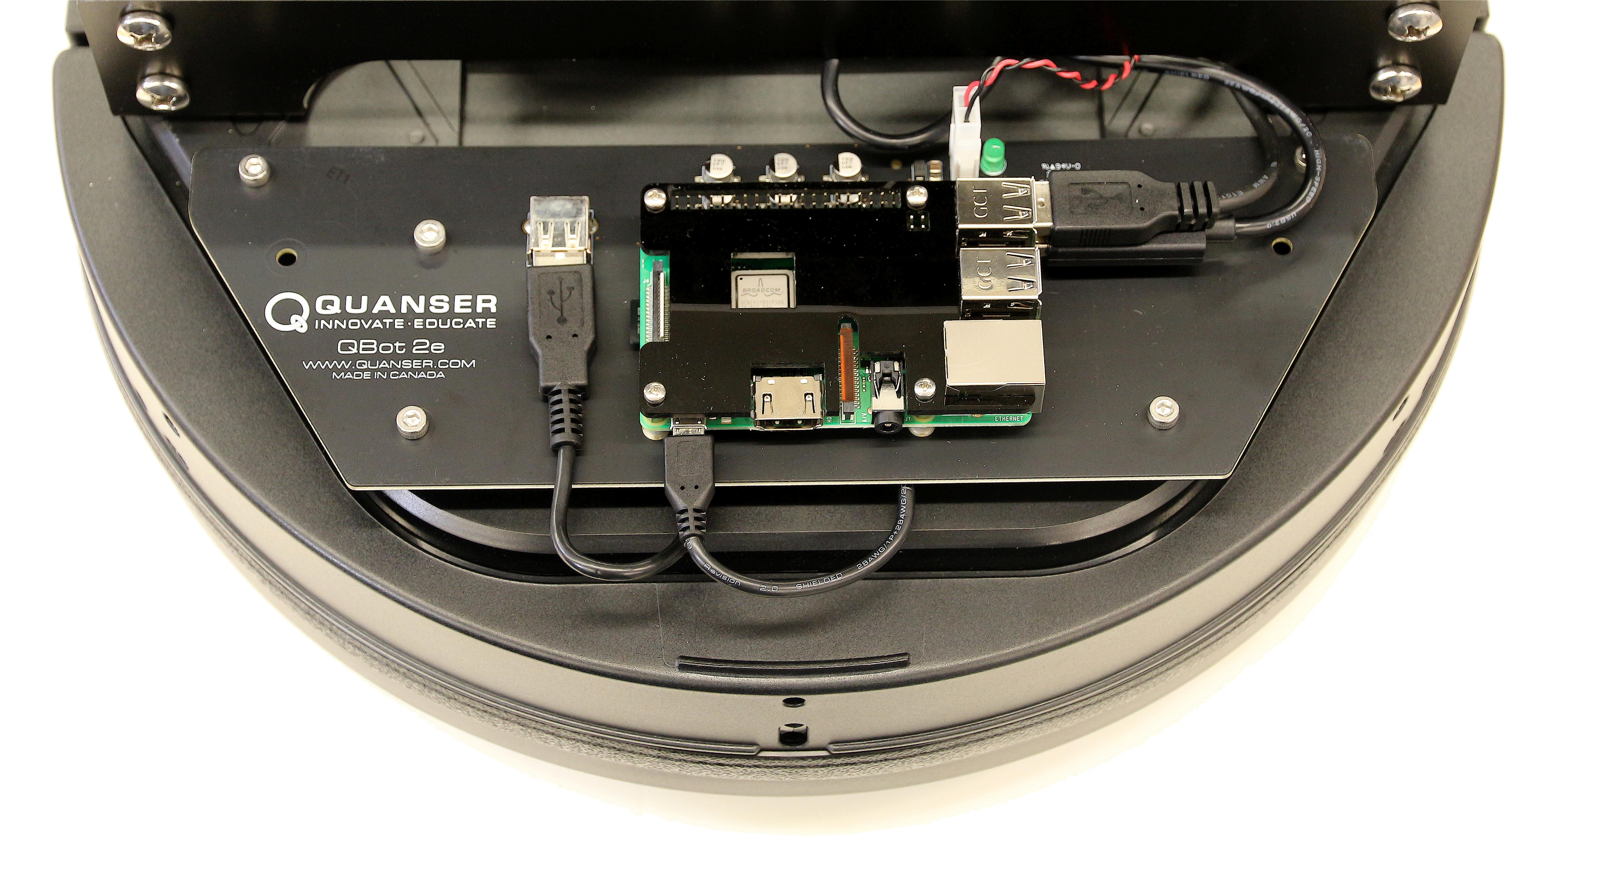
Data Acquisition
Onboard Computer:
Raspberry Pi with integrated WiFi
  Dual-core Texas Instruments OMAP4430 digital
  video processor
  ARMv8 Cortex-A53
  Integrated 802.11 b/g/n WiFi
Additional I/O Available
  28 reconfigurable digital I/O, including
  2 PWM output
  1 UART serial port
  1 SPI bus channels
  1 I²C serial bus channel

Slide 14
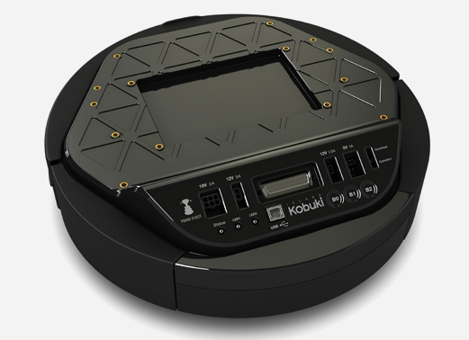
On-Board Sensors
Sensors Included
  3 digital bump sensors
  3 digital wheel drop sensors
  3 cliff sensors
  1 3-axis gyroscope
  2 analog motor current sensors
  1 Z-axis angle measurement
  2 wheel encoders
  2 programmable LEDs
  3 digital buttons
  2 over current sensors
  1 battery voltage sensor

Slide 15
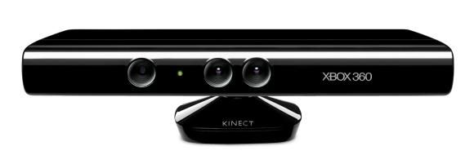
Vision
Microsoft Kinect RGBD Sensor
  640x480 resolution
  11 bit depth sensing
  0.5 – 6 m depth range

Slide 16
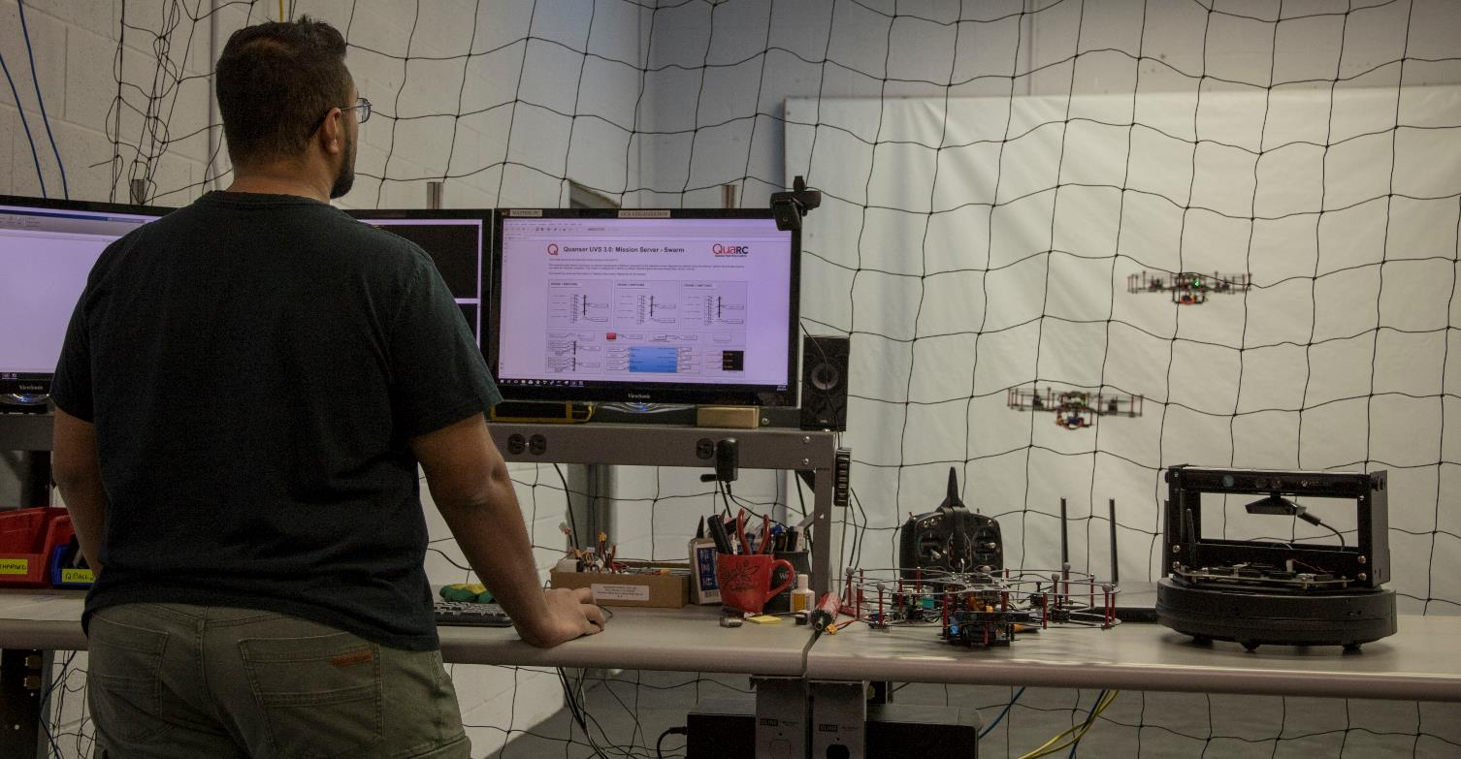
Ground Station and Studio

Slide 17
Ground Station and Studio
Ground Control Station
Studio Space Components
High performance computer
  Intel Core i7
  32GB DDR4 RAM
  Three monitors
USB flight controller
High performance router
Flex 13 Natural Point OptiTrack
Battery chargers
Protective net
Protective floor tiles
Ground camera

Slide 18
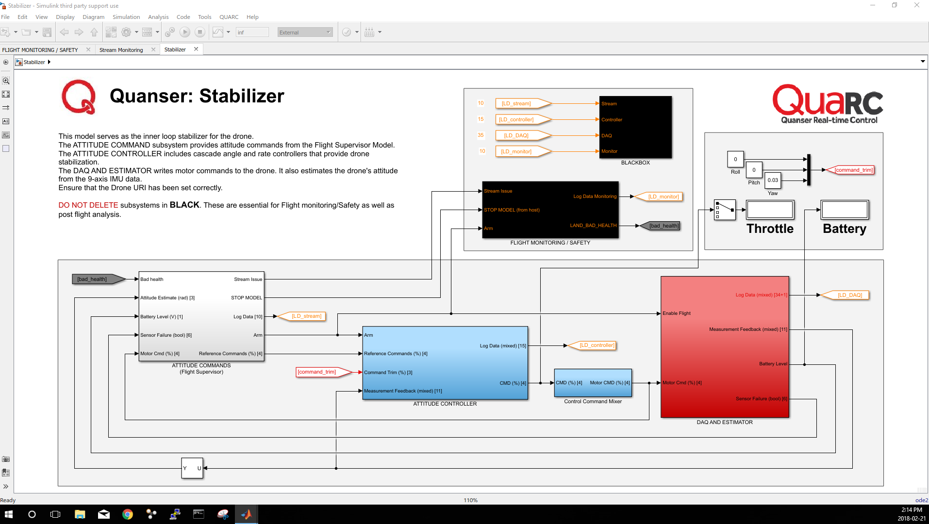
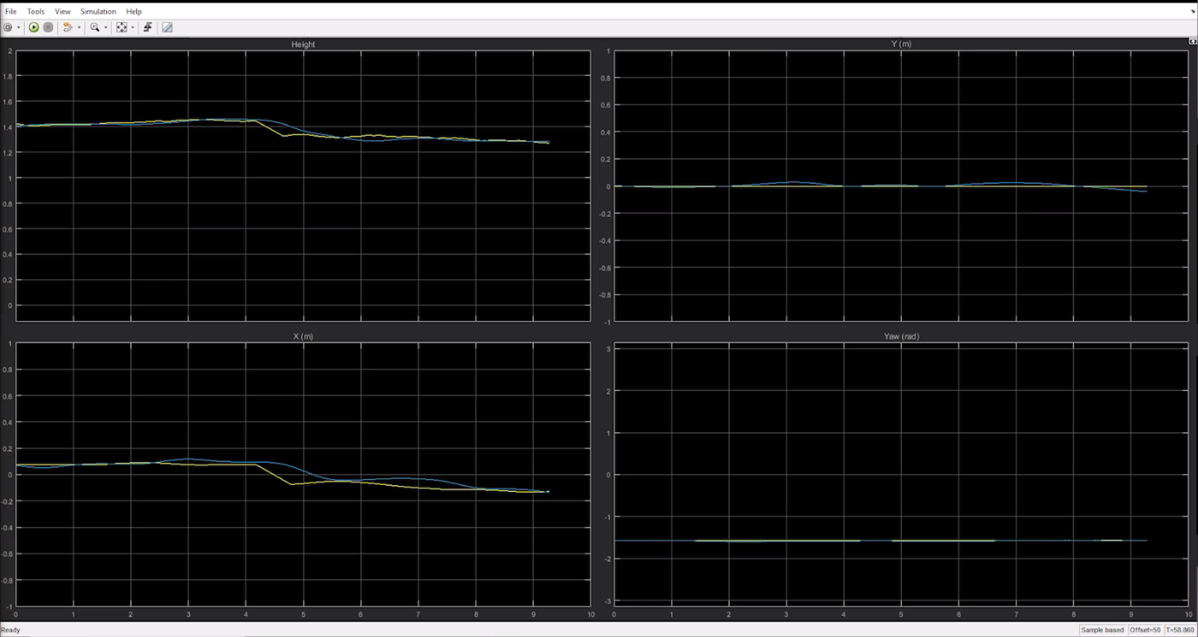


Direct-Access Architecture
Harness the power of Simulink® through the real-time capability of QUARC™
Build high-level applications and reconfigure low-level processes supported by prebuilt modules and libraries
Key functionalities required for multi-vehicle research
Harness the power of Simulink®
through the real-time capability of QUARC®

Slide 19
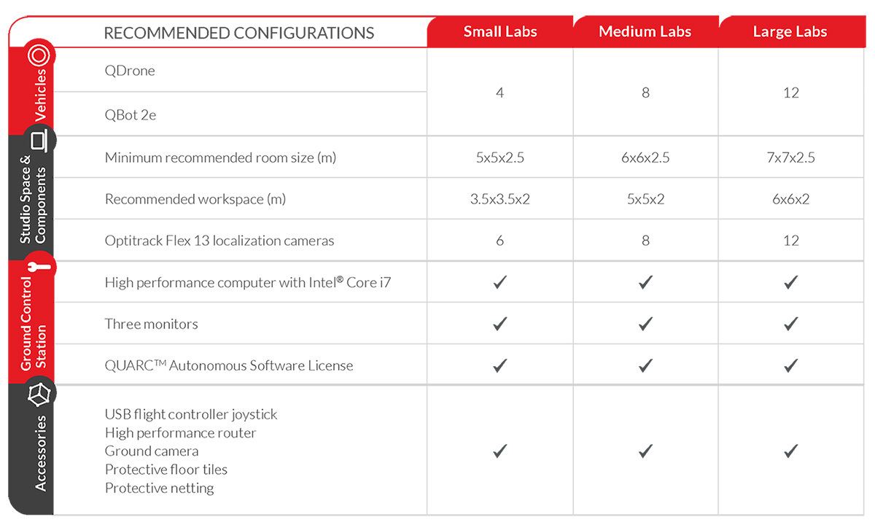
Studio Options

Slide 20






+
Notes:
We want to work with you to help realize the potential of your students today so that they can go on and perform Engineering Heroics tomorrow.
Our Mission: We Empower Engineering Heroes!
Quanser 101
Products & Technology 101
Research 101
Education 101

