Slide 1
QBot 2e
High-performance Autonomous ground robot for indoor labs

Slide 2
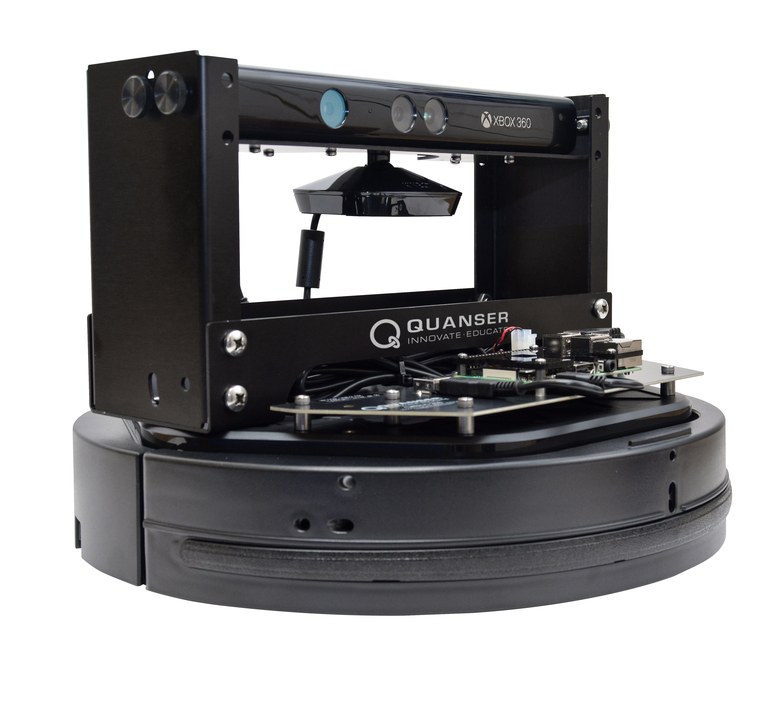
QBot 2e Features
Camera and depth sensor
Adjustable camera mounting
Additional I/O channels for customization
digital (SPI, UART, I²C) and analog sensors
Low-power on-board computer with integrated WiFi
2-wheel platform with built-in sensors
bumper sensors, wheel drop sensor, cliff sensor, wheel encoders
Mounting holes for sensor /load carrying structures

Slide 3
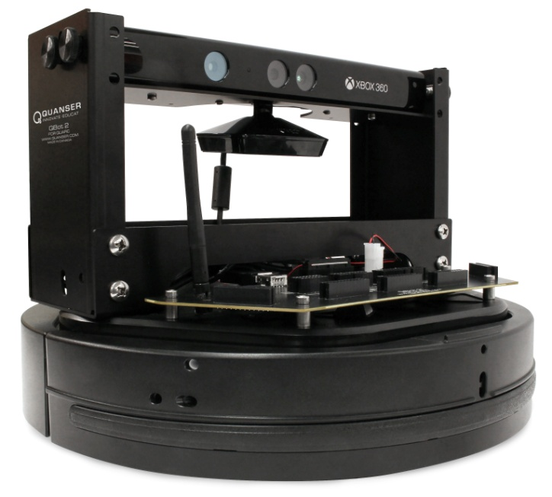
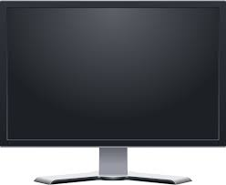
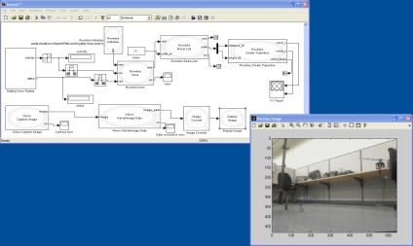
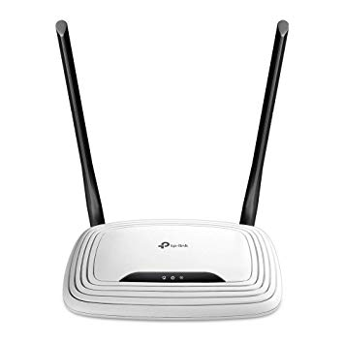
QBot 2e Bundle Components
QBot 2e ground robot
QUARC Autonomous License
Target – runs model/controller
Host - Design and develop controllers
Generate code
Wireless router
Communication - Send code to target
Send/receive scope data
Update runtime parameters
Notes:
The only open-architecture mobile ground robot for teaching and research, offered with curriculum for robotics and mechatronics courses.
Teaching and research applications:
Vehicle navigation and control
Autonomous vehicles
Machine and artificial vision
Artificial intelligence
High-level control architecture of mobile robots
Multi-agent navigation
Fault-tolerant control
And more ...
Affordable solution:
-Teach mobile robotics and mechatronics at undergraduate level hands-on
Expand use to capstone projects, advanced courses and research
Acquire multiple units
Modular courseware can be easily integrated into existing courses, covers topics of undergrad and advanced courses:
(U) Differential & inverse kinematics
(U) Odometric localization
(U) Deliberative, reactive and hybrid path planning
(A) Mapping
(A) Probabilistic map-based localization techniques
(A) Visual servoing and computer vision
Open architecture and customizable:
Expand use from undergrad teaching graduate level and research
Customizable for specific research needs: additional sensors, mounting holes, Optitrack camera system, integration of custom software (ROS)
Easily expandable to multi-vehicle research applications (compatible with other QBot 2 and Qbot units, Qball 2 and Qball-X4 units, third party)
High performance platform:
Wide range of sensors included - bumper sensor, wheel drop sensor, cliff sensor, wheel encoders, on-board Kinect vision system w tilt angle
On-board gumstix DuoVero computer and data acquision system
Operation time up to 7 h
Available payload app. 4.5 kg

Slide 4
QBot 2e Courseware
Locomotion and Kinematics
Mapping and Localization
Robot localization using particle filtering
Differential drive kinematics
Forward and inverse kinematics
Odometric localization and dead reckoning
Autonomous 2D mapping
Image Processing
Tresholding
Path Planning
Edge detection
Line following
Visual odometry
Occupancy grid mapping
Integration
Potential fields
A*
Voronoi
Actuation
Sensors
Kinect RGB
Kinect Depth
Notes:
This slide shows the lab exercises exactly as in the courseware vs. more generic courseware topics shown on the next slide – use the one you prefer

Slide 5
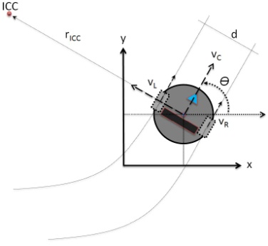
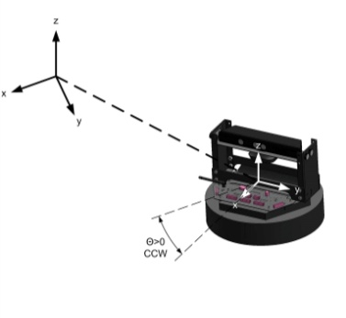
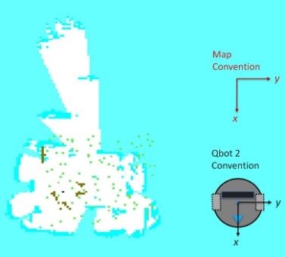
QBot 2e Courseware Topics
Differential drive kinematics
Forward and inverse kinematics
Dead reckoning and odometric localization
Path planning and obstacle avoidance
2D mapping and occupancy grid map
Image acquisition, processing and reasoning
Simultaneous localization and mapping (SLAM)
High-level control architecture of mobile robots
Vision-guided vehicle control

Slide 6
Quanser Autonomous Vehicles Research Studio
Camera localization system
QDrone quadrotors
Ground station with
QUARC software and router
QBot 2e ground robots

